Slide 1

Guide to Use JIRA
Manager Roles

Slide 2

Overview
Access to JIRA
Issue Navigator
Watch an issue
JIRA Dashboard
“Support” Project.

Slide 3
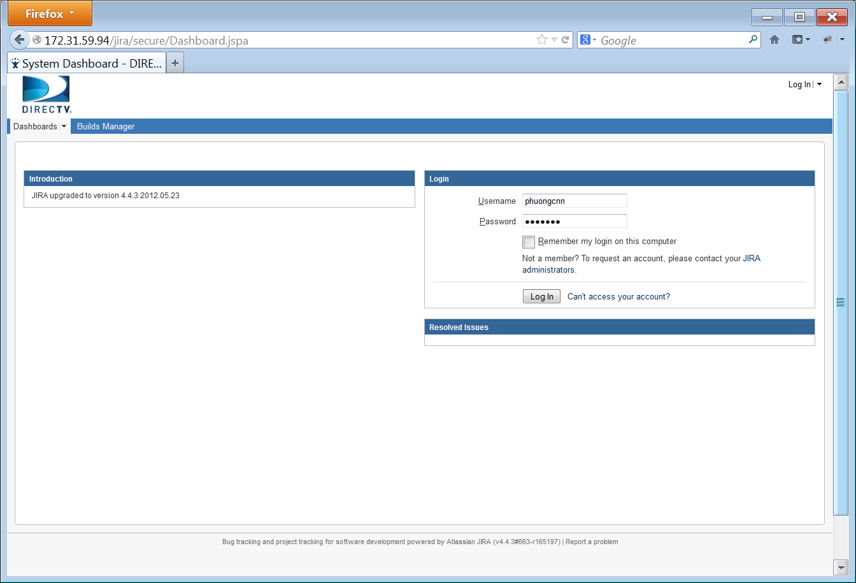
Access to JIRA
Use your web browser to access JIRA at: http://172.31.59.94/jira/
Login with your username and password to continue

Slide 4
Overview
Access to JIRA
Issue Navigator
Watch an issue
JIRA Dashboard
“Support” project

Slide 5
Searching Issues
Quick Search
Simple Search
Advanced Search
Issue Filters

Slide 6
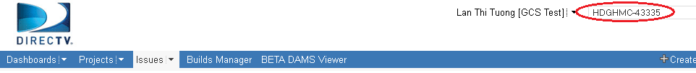
Searching issues – Quick Search
Quick Search supports to go directly to an issue by typing the issue key or run a free-text search.
Jump to an Issue:
The Quick Search box is located at the top right of any JIRA screen. If we type in a correct ID of an issue, we will jump straight to that issue
Ex: type in “HDGHMC-43335” and press Enter, you will be redirected to the JIRA issue with ID = “HDGHMC-43335“

Slide 7
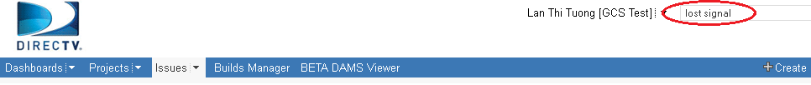
Quick Search – Free text searching
We can search for any word within the issue(s) we are looking for, provided the word is in one of the following fields.
Summary.
Description.
Comments.
Ex: type the string “lost signal” and click Enter, all the issues which contain “lost”, “signal”, “lost signal” are listed on the right hand side of the screen as the search results

Slide 8
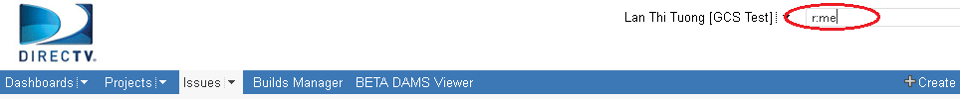

Quick Search – Smart querying
Quick Search also let users perform “smart” searches with minimal typing, called “Smart Querying”. The following table lists some search terms that Quick Search support:
Search Terms | Description | Sample
my | Find issues assigned to me. | my
r: | Find issues reported by you, another user. Using the prefix r: followed by a specific reporter term such as me, username. | r:me – your issues r:lantt – “lantt” issues
<priority> | Find issues with a particular Priority. | Blocker, Low, Critical
<issue type> | Find issues with a particular Issue Type. | Bug, Task, New Feature
Type “r:me” text and press Enter, all the issues created by “me” (current user) will be listed in search results.

Slide 9
Searching issues
Quick Search
Simple Search
Advanced Search
Issue Filters

Slide 10
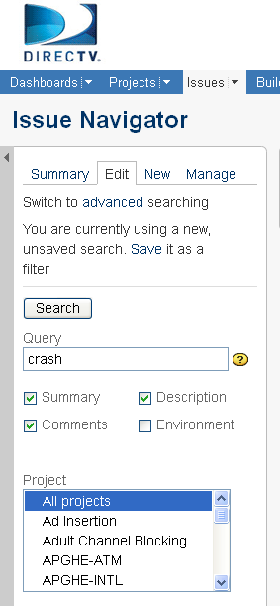
Searching issues – Simple Search
JIRA has a powerful search capability in the simple mode. We can search for issues across projects, versions and components using a range of filter criteria.
How to perform a search:
On the top navigation bar, click the 'Issues' tab => the Issues Filter form is displayed on the left hand side of the screen.
Type your search term into the 'Query' box, and/or select other criteria from the drop-down boxes and check-boxes.
Click on the 'Search' button to perform the search => your search results will be displayed in the right hand side of the screen.

Slide 11
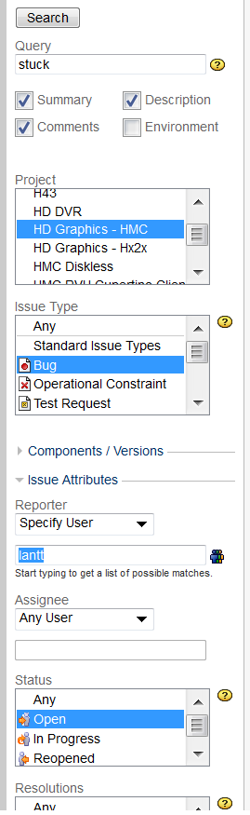
Simple search – example
Simple search example:
To search for all bugs opened by user “lantt”, in “HD Graphics – HMC” project, with “Open” status and contain “stuck” text in their Summary, Comments or Description, the filter should be:
Query string: stuck
Check the boxes: Summary, Comments, Description
Project: HD Graphics – HMC
Issue Type: Bug
Reporter: lantt
Status: Open
Click on the 'Search' button => the search results will be displayed in the right hand side of the screen.

Slide 12
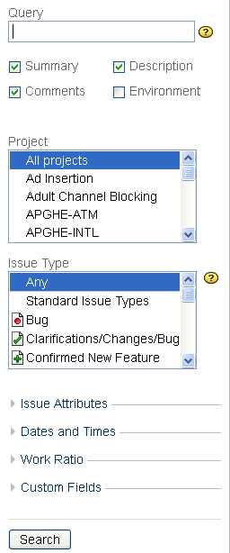
Simple search – criteria groups
In simple search mode, there are many criteria groups to narrow your search:
Simple filter with Query, Project, Issue Type criteria.
Issue Attributes: we can filter for Reporter, Assignee, Status, Resolutions, Priorities, Label.
Date and Times: we can filter for Created After, Created Before, Created, Updated After, Updated Before, Updated, Due After, Due Before, Due Date, Resolved After, Resolved Before, Resolved.
Work Ratio: we can filter for % done of issues (% Limits).
Custom Fields: we can filter for Assignee History, Date of First Response (after), Date of First Response (before), Date of First Response, Executive Visibility, Platform/s, Time in Status.

Slide 13
Searching issues
Quick Search
Simple Search
Advanced Search
Issue Filters

Slide 14
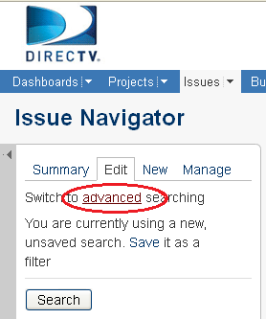

Searching issues – Advanced Search
An advanced search allows you to use structured queries to search for issues.
To perform an Advanced Search:
On the top navigation bar, click the "Issues" tab => This will display the Simple Search panel on the left hand side of the screen.
Click on "advanced“=> This will display the "Query" box.
Type your query using the fields, operators and field values/functions.
Click the "Search" button to run your query => The search results will be displayed below the query.

Slide 15
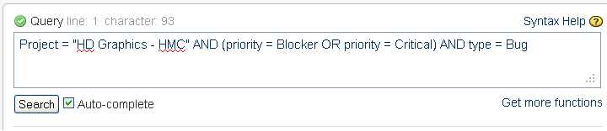
Advanced Search – Example
Example:
If you want to search for all bugs which belong to “HD Graphics – HMC” project and their priority are “Blocker” or “Critical”, type the following string into the query box:
Project = “HD Graphics – HMC” AND (priority = Blocker OR priority = Critical) AND type = Bug
Click "Search" button, and see the result

Slide 16
Advanced Search – keywords and syntax
Supported keywords, operators, fields, functions (refer to JIRA online help for a complete list)
Keywords: OR, AND, NOT, EMPTY, NULL, ORDER BY
Operators: =, !=, >, <, >=, <=, IN, NOT IN, ~ (contain), !~,…
Fields: assignee, created, category, project, priority, reporter, status, text, type, updated, description, watcher, resolution,…
Functions: membersOf(), currentUser(), currentLogin(), lastLogin(), startOfDay(), endOfDay(), startOfWeek(), endOfWeek(), startOfMonth(), endOfMonth(), releasedVersions(), unreleasedVersions(), latestReleasedVersion(), earliestUnreleasedVersion()…
JIRA supports Auto-complete function: As you type your query, JIRA will recognize the context and offer a list of "auto-complete" suggestions for you.
We can save the query for future use. We can also share the query with Group, Project or Everyone to utilize it.

Slide 17
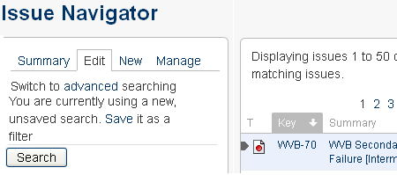
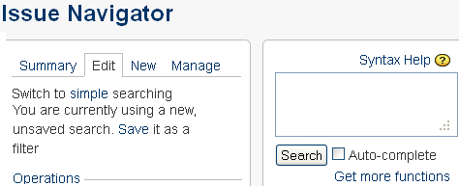
Switching between Advanced and Simple Search
On the top navigation bar, click the "Issues" tab. This will display the Search panel, this is also Simple Search page. On this, click "advanced". This will display the "Query" box of Advanced Search.
The same, on Advanced Search page, click on “simple” to switch back to Simple Search.
In general, a query created using 'Simple Search' will be able to be translated to 'Advanced Search‘, and back again. However, a query created using 'Advanced Search' may not be able to be translated to 'Simple Search‘, particular if the query contains one of below operator: OR, NOT, EMPTY, !=, IS, IS NOT, >, >=, <, <=, or the query specifies a field and value that is related to a project.

Slide 18
Searching issues
Quick Search
Simple Search
Advanced Search
Issue Filters

Slide 19

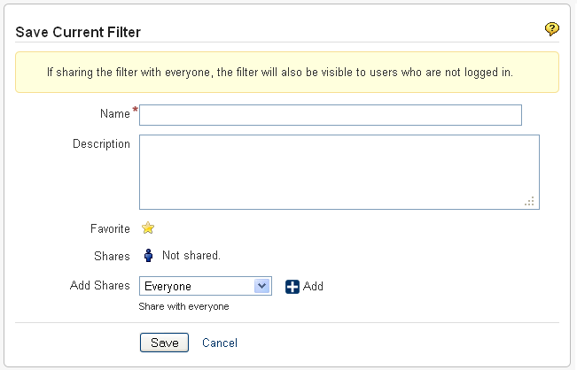
Issue Filters - Saving Searches
A saved search is called an 'issue filter'.
After doing your search, click the ‘Save it as a filter’ link in the left-hand column of the Issue Navigator.
Provide a name, description, favorite, share or not, then save your filter.

Slide 20
Issue Filters – Manage Filter
On the top navigation bar, click the 'Issues' dropdown and select 'Manage Filters' from the list.
The 'Manage Filters' page will display. From this page, you can perform the functions listed below:
Create a new search to be saved as a filter.
Add a filter as a favorite.
Share a filter that you have created with other users.
Search for filters that has been created by you or shared with you by other users.
Update an existing filter's details or edit a filter's search criteria for a filter that you have created.

Slide 21
Overview
Access to JIRA
Issue Navigator
Watching an issue
JIRA Dashboard
“Support” Project.

Slide 22
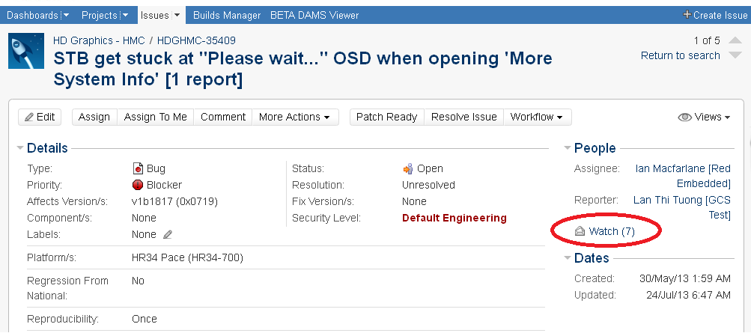
Watching Issues
JIRA allows users to watch for a particular issue, all watchers will be notified by email for any updates or comments on that issue.
Click on the “Watch” icon to become a watcher of the issue.
Click on the “Watch” icon again to stop watching the issue.

Slide 23
Overview
Access to JIRA.
Issue Navigator.
Watching an issue.
JIRA Dashboard.
“Support” Project.

Slide 24
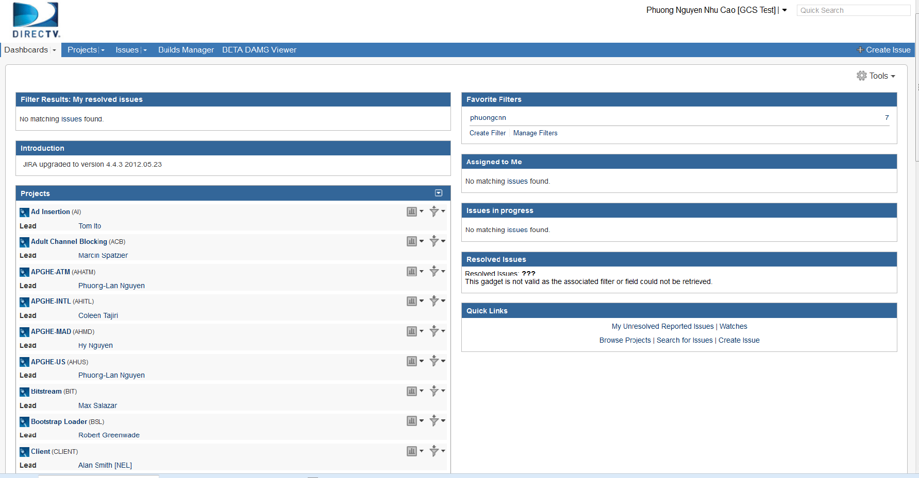
Dashboard
JIRA Dashboards is the first screen you see after you log into JIRA.
It can be configured to display many different types of information, depending on each user’s interest.
If you have not created any dashboard, you will see the system dashboard as below.
The information boxes on the dashboard are called Gadgets.
Notes:
The JIRA Dashboards is the first screen you see when you log in to JIRA.
It can be configured to display many different types of information, depending on your areas of interest.
The information boxes on the dashboard are called Gadgets

Slide 25
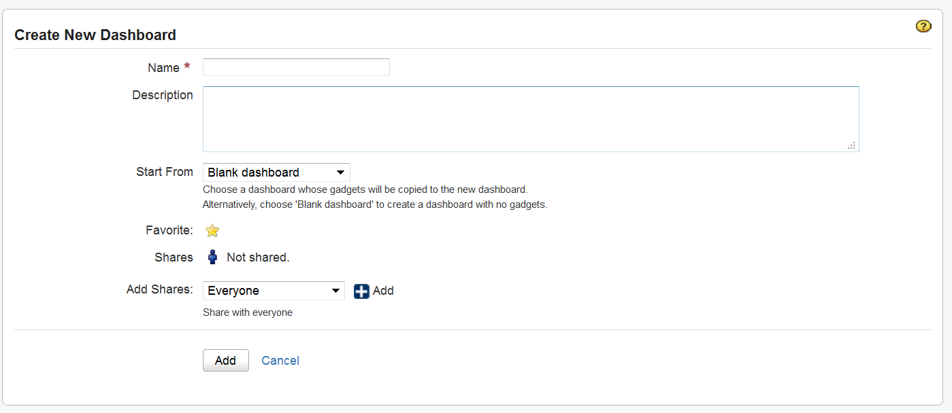
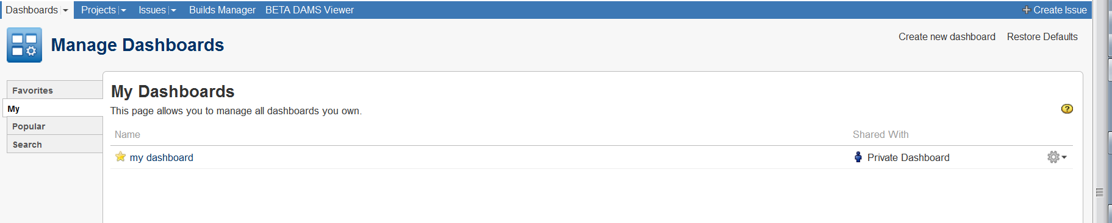
Dashboard – Create new dashboard
Create new dashboard from blank.
Notes:
Here I click on “Create New Dashboard”
I name the Dashboard “my first dashboard”->Start From Blank dashboard ->Select Favorite->Shares : Not shared so only I can see and use this dashboard.
Then click Add.
Now select the “blank dashboard” I just created.

Slide 26
Dashboard – Customize Dashboard
You can easily customize your dashboard by
Add more gadgets
Drag and drop to reposition the gadgets
Change the look of individual gadgets
Choosing a different layout
You can also
Create more pages for your dashboard
Share your pages with other people
Choose your favorites pages

Slide 27
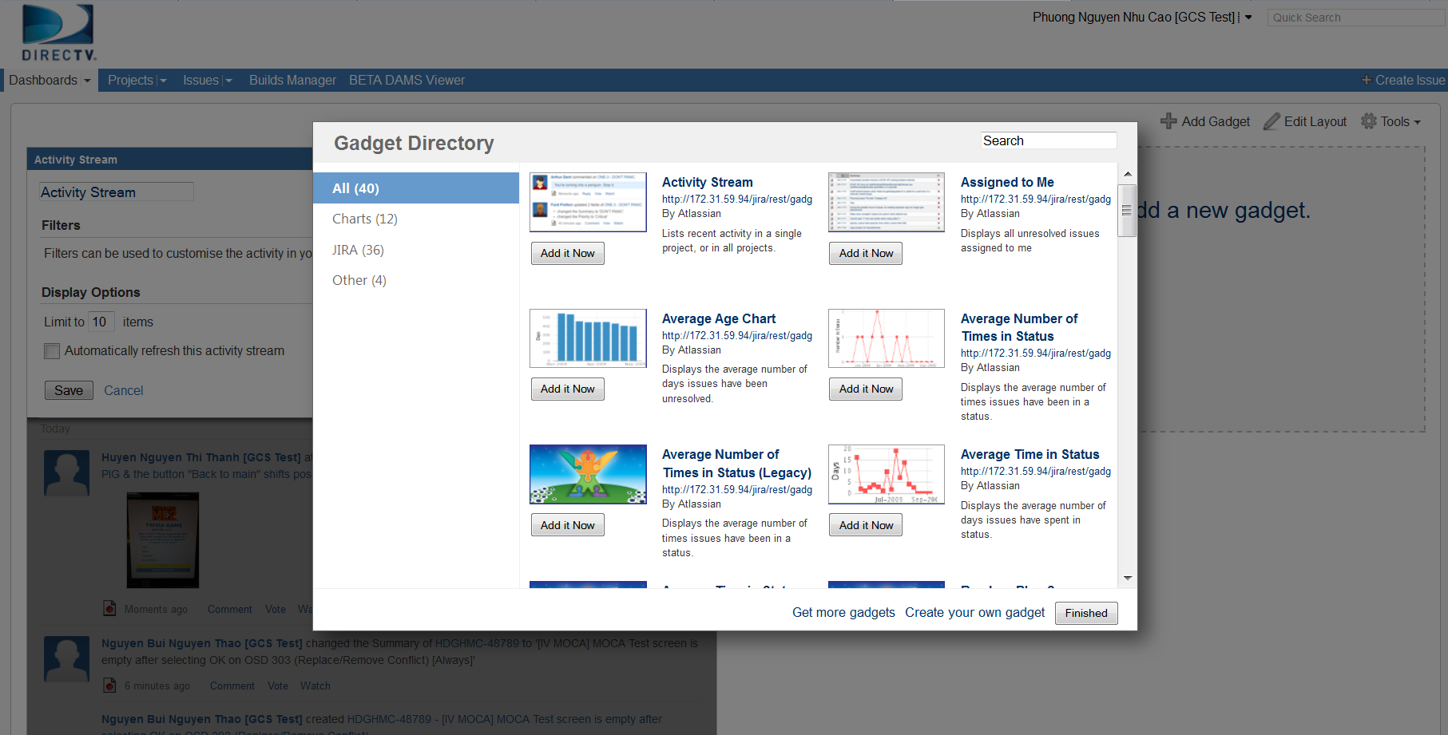
Dashboard customization – add gadgets
Add gadgets to dashboard.
Notes:
Click on “add new gadget”
Then select the “Gadget You can easily customize your dashboard by choosing a different layout, adding more gadgets, dragging the gadgets into different positions, and changing the look of individual gadgets.

Slide 28
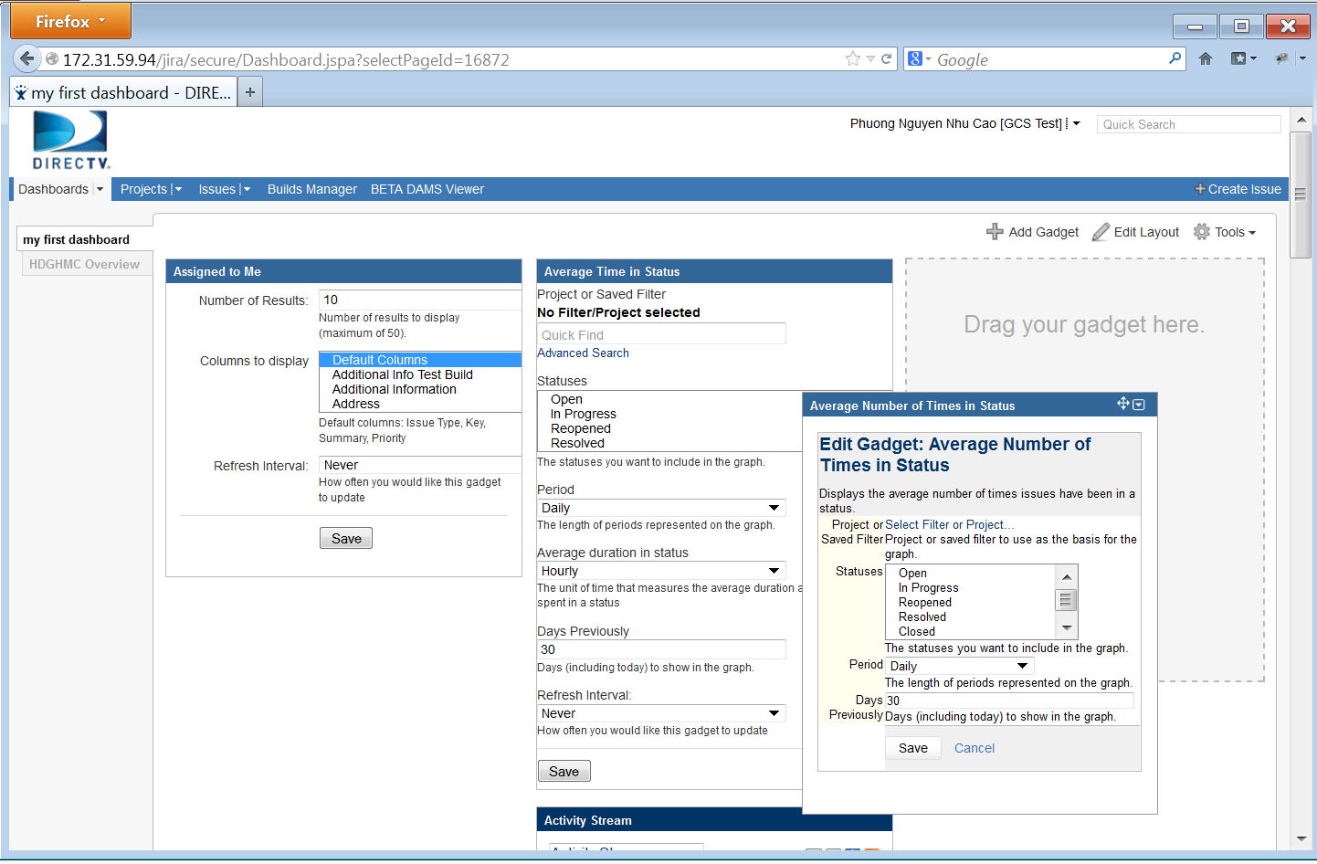
Dashboard customization – drag and drop
Click on the header of each gadget
Drag it to the desired location to reposition

Slide 29
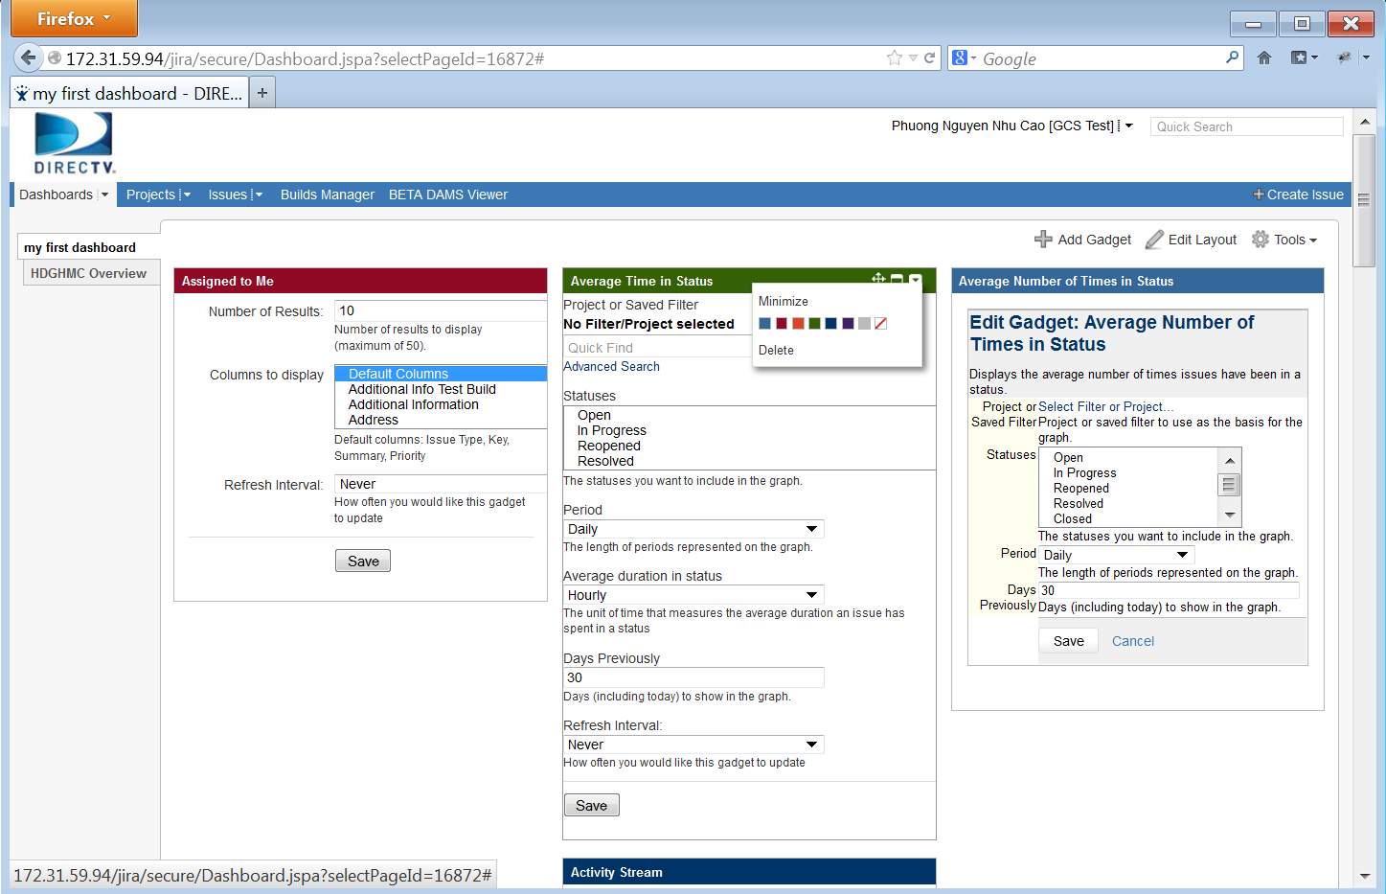
Dashboard customization – change gadget style
You can change the individual look of a gadget by clicking the dropdown icon from gadget header, then choose desired color

Slide 30
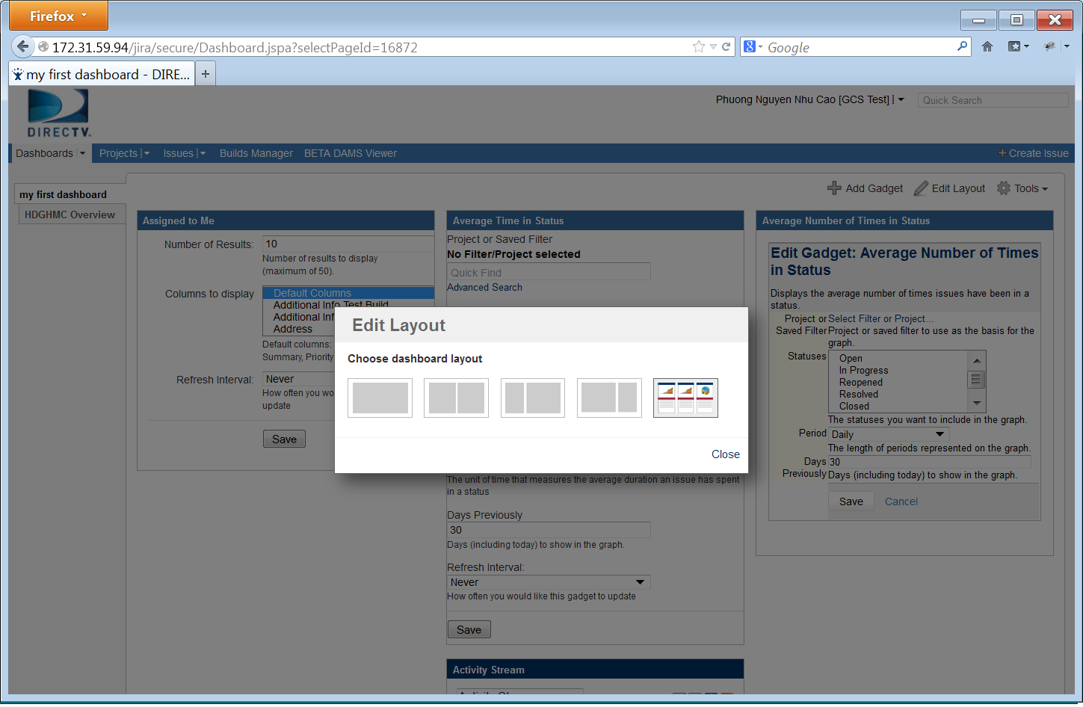
Dashboard customization - layout
You can easily customize your dashboard by choosing a different layout
Click "Edit Layout", then choose the layout you want

Slide 31
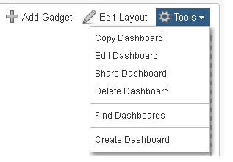
Dashboard – Customize Dashboard
Copy Dashboard
Edit Dashboard
Share Dashboard
Delete Dashboard
Find Dashboard
Create Dashboard

Slide 32
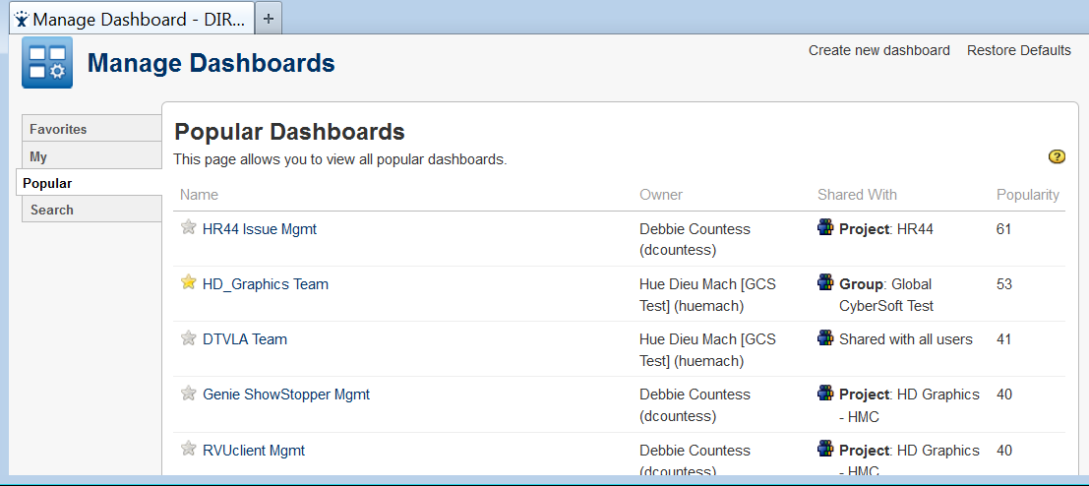
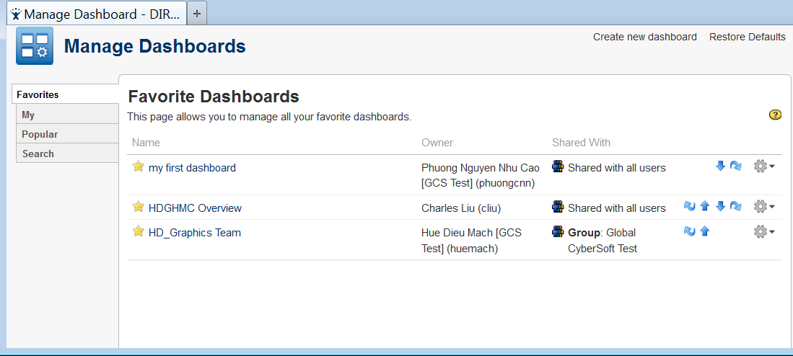
Dashboard – Customize Dashboard (cont.)
You can add pages to your favorite.

Slide 33
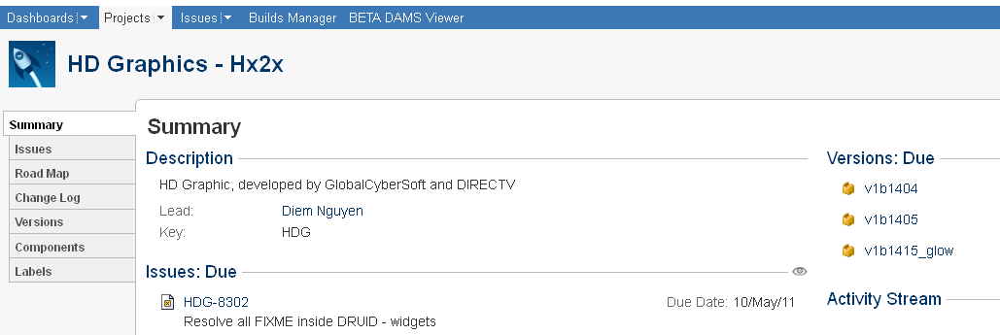
Browsing a Project
The project browser screen: provides a general overview of your project, with a variety of easily accessible reports for your project's issues, builds and source code reviews, from which you can 'dig down' into further detail.

Slide 34
Browsing a Project – Project Information
Choosing a project, then you can browse the following:
Summary: Shows recent activity in your project
Issues: Shows a summary of all issues in a project grouped by Status
Road Map: Shows unresolved issues for upcoming versions of a project.
Change Log: Shows resolved issues for previous versions of a project.
Versions: Shows a summary of recent versions for a given project.
Components: Shows a summary of all components for a given project.
Labels: shows all the most popular labels and its associated content.

Slide 35
Overview
Access to JIRA.
Issue Navigator.
Watching an issue.
JIRA Dashboard.
“Support” Project.

Slide 36
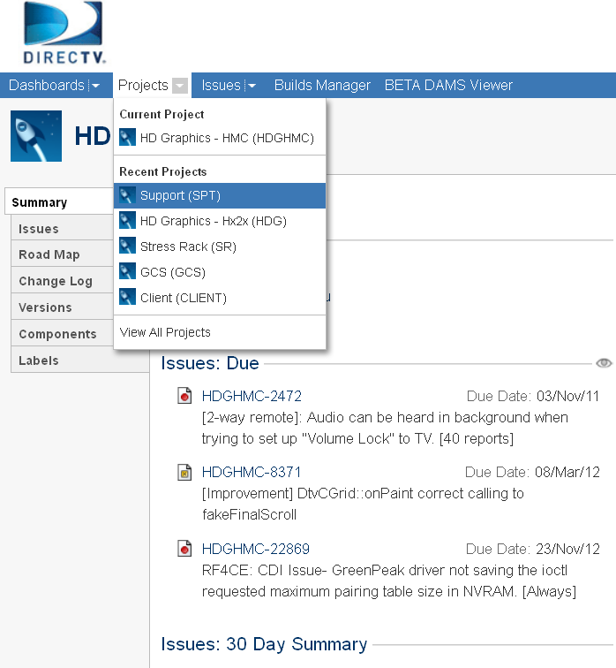
Support project
When managers or supervisors request the Support team to help them on creating or updating an Open Air Account, providing Virtual Machine, doing a Task, creating new Project, they have to submit tickets on "Support" project.

Slide 37
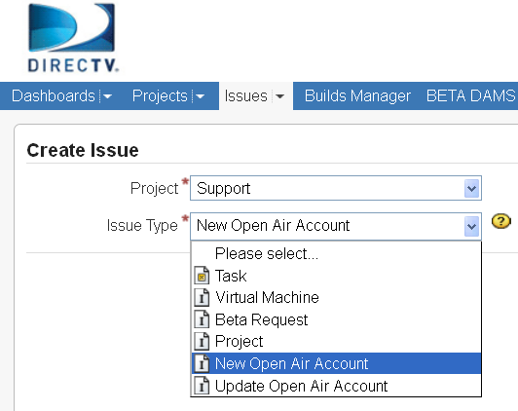
Support project (cont.)
The "Support" project provides the following issue types to classify the works:
Virtual Machine: request for a Virtual Machine.
Beta Request: request for creating a beta version.
Project: request for creating a new project.
New Open Air Account: request for creating a new Open Air Account for a new employee.
Update Open Air Account: request for updating an existing Open Air Account.
Task: any request that is not in the above types.
(Support also used for any activity that could be done by Engineering Support Team to support test activities except corporate IT. Examples are requesting HW, upgrading HW, requesting SW, installing and sending CAPs.)

Slide 38
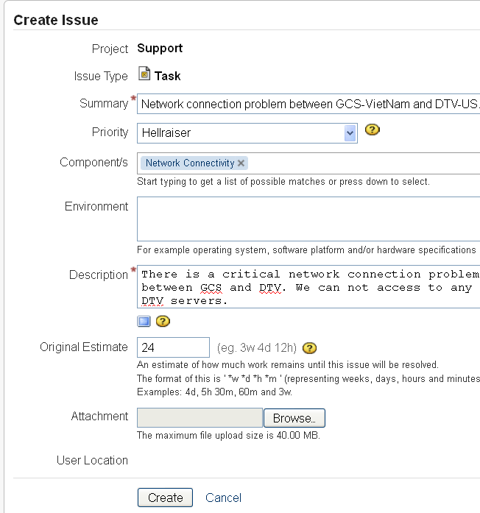
Support project (cont.)
For example, we are facing a network connection problem. I will create a request for fixing it.
The ticket should be:
Project: Support.
Issue Type: Task.
Priority: Hellraiser.
Component/s: Network Connectivity.
Description: There is a critical network connection problem…
Original Estimate: 24h.
Then click on "Create" button to create the ticket.

Slide 39
Thank you

